Slide 1



UNLOCK. ANALYSE. EMPOWER.
Intelligent BAF scheduler using Combinatorial Optimization
Making Analytics Real, Valuable, Efficient & Logical

Slide 2
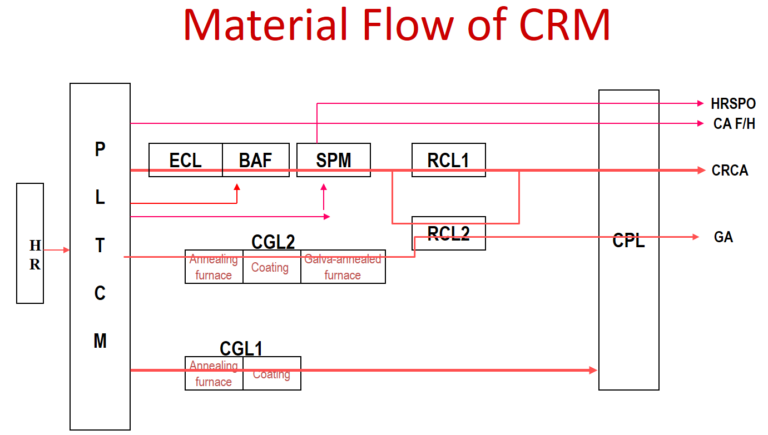
SUMMARY
Background
Steel coils goes through annealing process. The process is carried out in batch of coils stacked vertically in Batch Annealing Furnace (BAF).
Flow of coils across mills is as follows:
KPIs (UoM, Baseline and Target)
Current capacity utilization and target:
KPI | Actual (tn) | Target tn) | Improvement (tn)
Average stack weight (tn) | 99 | 102 | 3
Business Need / Objective
BAF is one of the major bottlenecks in downstream steel making process and it is working with capacity of 99tn stack weight even though rated capacity is 107tn stack weight.
Project idea is to provide an analytical model which would optimize the coil selection process to maximize height of the stack in BAF.
Project Scope
Scope of project is limited to optimizing coil stack height based on inventory data fed into the model. It would not suggest width of coil to be rolled to optimize BAF production.
Integration with present MES system is not in scope. It is expected to be taken as next phase of the project based on output of the model

Slide 3
SUMMARY
As-Is process
The scheduling system which is in use need manual selection of coil id.
Logic / constraints are know only to the operator which is again a manual process
To be process
System generated schedule considering all constraints with primary objective to increase throughput.
Assumption/Dependency
Handling equipment is not a constraint in moving coils from yard to BAF.
(to be updated)
Design of the system
Solution approach to the problem are in three steps:
Initial process would be to group the inventory in such a way coils in the same group can be loaded together in the furnace.
Run ‘Intelligent BAF scheduler’.
The problem is similar to knap sack problem of combinatorial optimization. The model will work on algorithm of combinatorial optimization to arrive at best combination of coil height.
After stack combinations is made for a BAF, stacking constraints would be checked to identify the sequence of coil to be kept one over the other.
Deliverables / Product Description
There are 2 deliverables for the project.
Based on available inventory at BAF coil yard, the best stack can be made.
Based on coils which would come to BAF coil yard from PLTCM, ECL and HSM, future plan on coil scheduling can also be made.
These 2 solutions are named as:
Day 0 → from BAF inventory
Day 1 to 4 → from PLTCM, ECL and HSM inventory + rolling plan
Acceptance Criteria
Model is expected to provide average stack weight more than 99tn.
Stacking plan for coils which are expected to come from PLTCM, HSM and ECL.

Slide 4
Project Value
 | Month | Year
Total stack (nos) | 745 | 8940
Total tonnage | 73755 | 885060
Target improvement (tn) | 2235 | 26820
Value (INR in Cr) | 0.33 | 4.02
Above calculation is based on:
Current BAF stack weight as 99 tn
Target BAF stack weight as 102 tn
Total number of BAF – 48 in number
Average time / stack – 42-43 hours (Considering 60% CQ/DQ material and 40% EDD/EIF material)
NR value – Rs.1500

Slide 5

VISUAL SCREEN
Feed
BAF STACKER
Number of Schedule
Grade
EXECUTE
RUN SCHEDULE
Total stack weight
DOWNLOAD
PROJECTION

Slide 6
VISUAL SCREEN
Feed
BAF STACKER
Day
Grade
EXECUTE
RUN SCHEDULE
Total stack weight
DOWNLOAD
PROJECTION

Slide 7
DATA FLOW
Order book
Run Schedule
Pre BAF inventory
Pre ECL inventory
Pre PLTCM inventory
Visual screen with option to download to excel
Copy paste ‘Coil IDs’ in BAF scheduler
Projection
HR ready – Cooling > 40hrs
HR ready – Cooling < 40hrs
HR WIP

Slide 8
DATA REQUIRED
Run Schedule
(Day 0 will take data of Pre BAF)
Projection
(Day 1 to Day 4, will take data as mentioned in the table)

Slide 9
INVENTORY to be considered
Inventory to be selected for the listed coil status of specific inventory location

